Slide 1
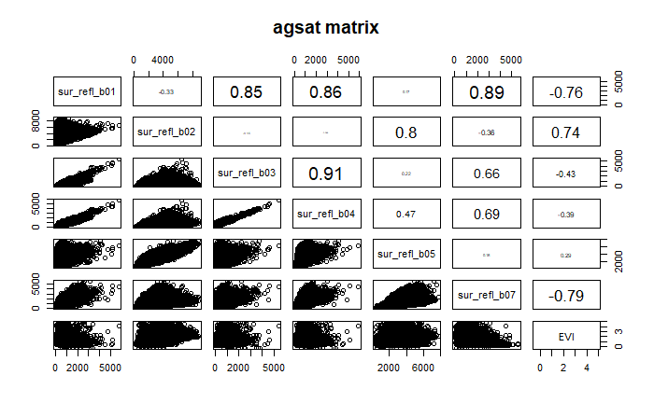
Based on spectral and phenological differences, target mid to late vegetative stage of first crop and the whole second crop; avoid dry season
Use only ‘useful’ bands and times of year as input data
Use two sets of input data:
Band1 and band2 from December to June
EVI from December to June

Slide 2
Soymaps
Evaluate not only for Planet images (which are heavy on DC and therefore give overly optimistic estimate of accuracy), but also produce confusion matrix from the actual sample points
 | Class | Jake’s | Soymap 1 | Soymap 2 | Soymap 3 | Soymap 4 | Soymap 5 | Soymap 6
Training points |  | Agsat | Agsat | Agsat + PLOS | Agsat + PLOS | Agsat + PLOS | Agsat + reclassed PLOS | Agsat
Input data |  | Aqua + landsat | Aqua + landsat | Aqua | Aqua B1 + B2, Dec to June | Aqua EVI, Dec to June | Aqua EVI, Dec to June | Aqua EVI, Dec to June
Accuracy |  | 76 | 76.9 | 73.5 | 75.2 | 76.7 | 78.5 | 79.7
Consumer’s accuracy | 0 | 0.39 | 0.51 | 0.45 | 0.44 | 0.52 | 0.54 | 0.51
 | 1 | 0.85 | 0.85 | 0.8 | 0.8 | 0.8 | 0.82 | 0.84
 | 2 | 0.47 | 0.4 | 0.35 | 0.44 | 0.53 | 0.46 | 0.47
Producer’s accuracy | 0 | 0.39 | 0.47 | 0.35 | 0.25 | 0.24 | 0.29 | 0.33
 | 1 | 0.85 | 0.86 | 0.86 | 0.9 | 0.92 | 0.92 | 0.92
 | 2 | 0.44 | 0.47 | 0.3 | 0.37 | 0.4 | 0.35 | 0.31

Slide 3
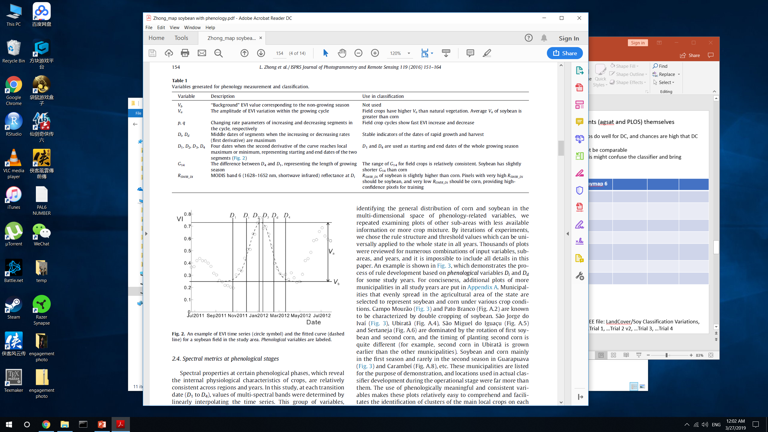
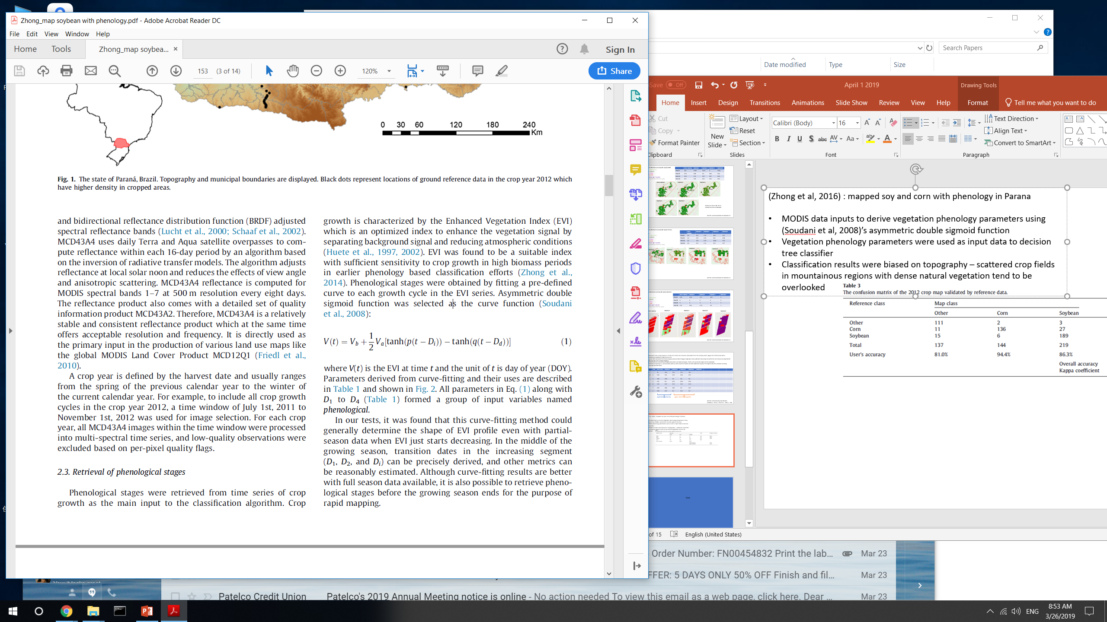
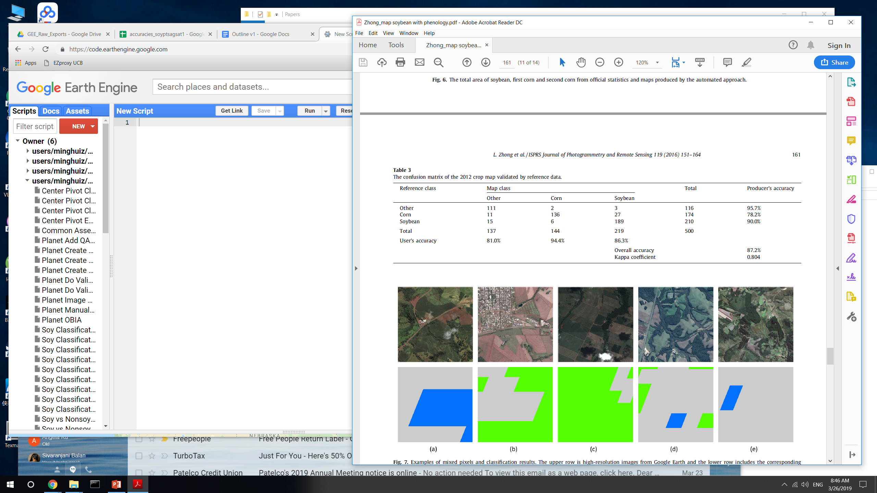
(Zhong et al, 2016) : mapped soy and corn with phenology in Parana
MODIS data inputs to derive vegetation phenology parameters using (Soudani et al, 2008)’s asymmetric double sigmoid function
Vegetation phenology parameters were used as input data to decision tree classifier
TAKEAWAY: improvement using different inputs based on MODIS bands is only incremental. Need phenological information.

Slide 4
 | Class | Soymap 7 | Soymap 8 | Soymap 9 | Soymap 10
Training points |  | Agsat | Agsat | agsat | Agsat
Input data |  | Phenology | Phenology + aqua + terra B1 and B2 | Phenology + aqua + terra B1 and B2, smoothed | Phenology + aqua + terra EVI, smoothed
Accuracy |  | 81.8 | 81.1 | 78.8 | 82.5
Consumer’s accuracy | 0 | 0.58 | 0.58 | 0.47 | 0.59
 | 1 | 0.86 | 0.85 | 0.84 | 0.86
 | 2 | 0.57 | 0.58 | 0.49 | 0.65
Producer’s accuracy | 0 | 0.44 | 0.35 | 0.33 | 0.44
 | 1 | 0.92 | 0.93 | 0.91 | 0.92
 | 2 | 0.4 | 0.47 | 0.36 | 0.44
Next?
Starting from Soymap 6 (which doesn’t rely on timing map), add in cloud masking; smoothing; and terra in addition to aqua
Starting from Soymap 10, fine-tune the input data more; or take out phenological data and just use spectral data (at specific phenological stages)

Slide 5
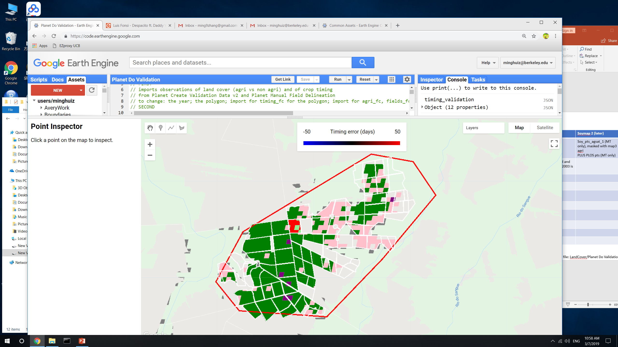
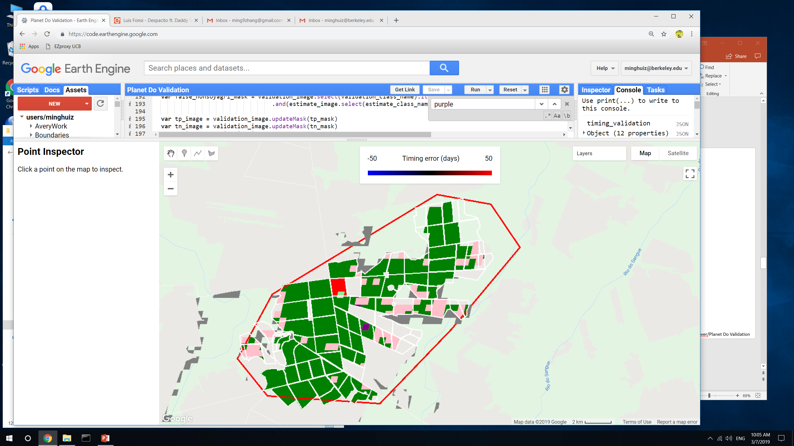
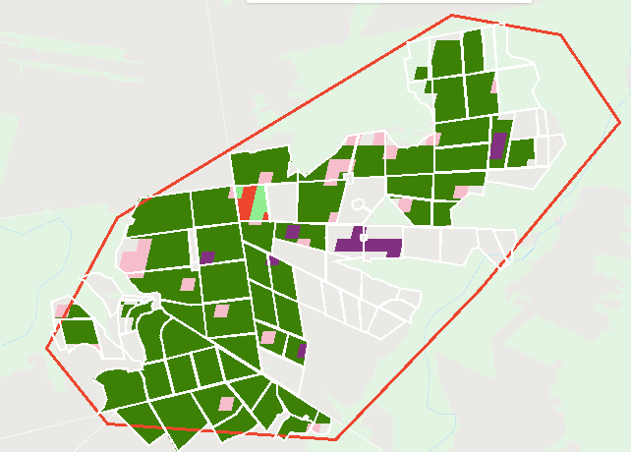
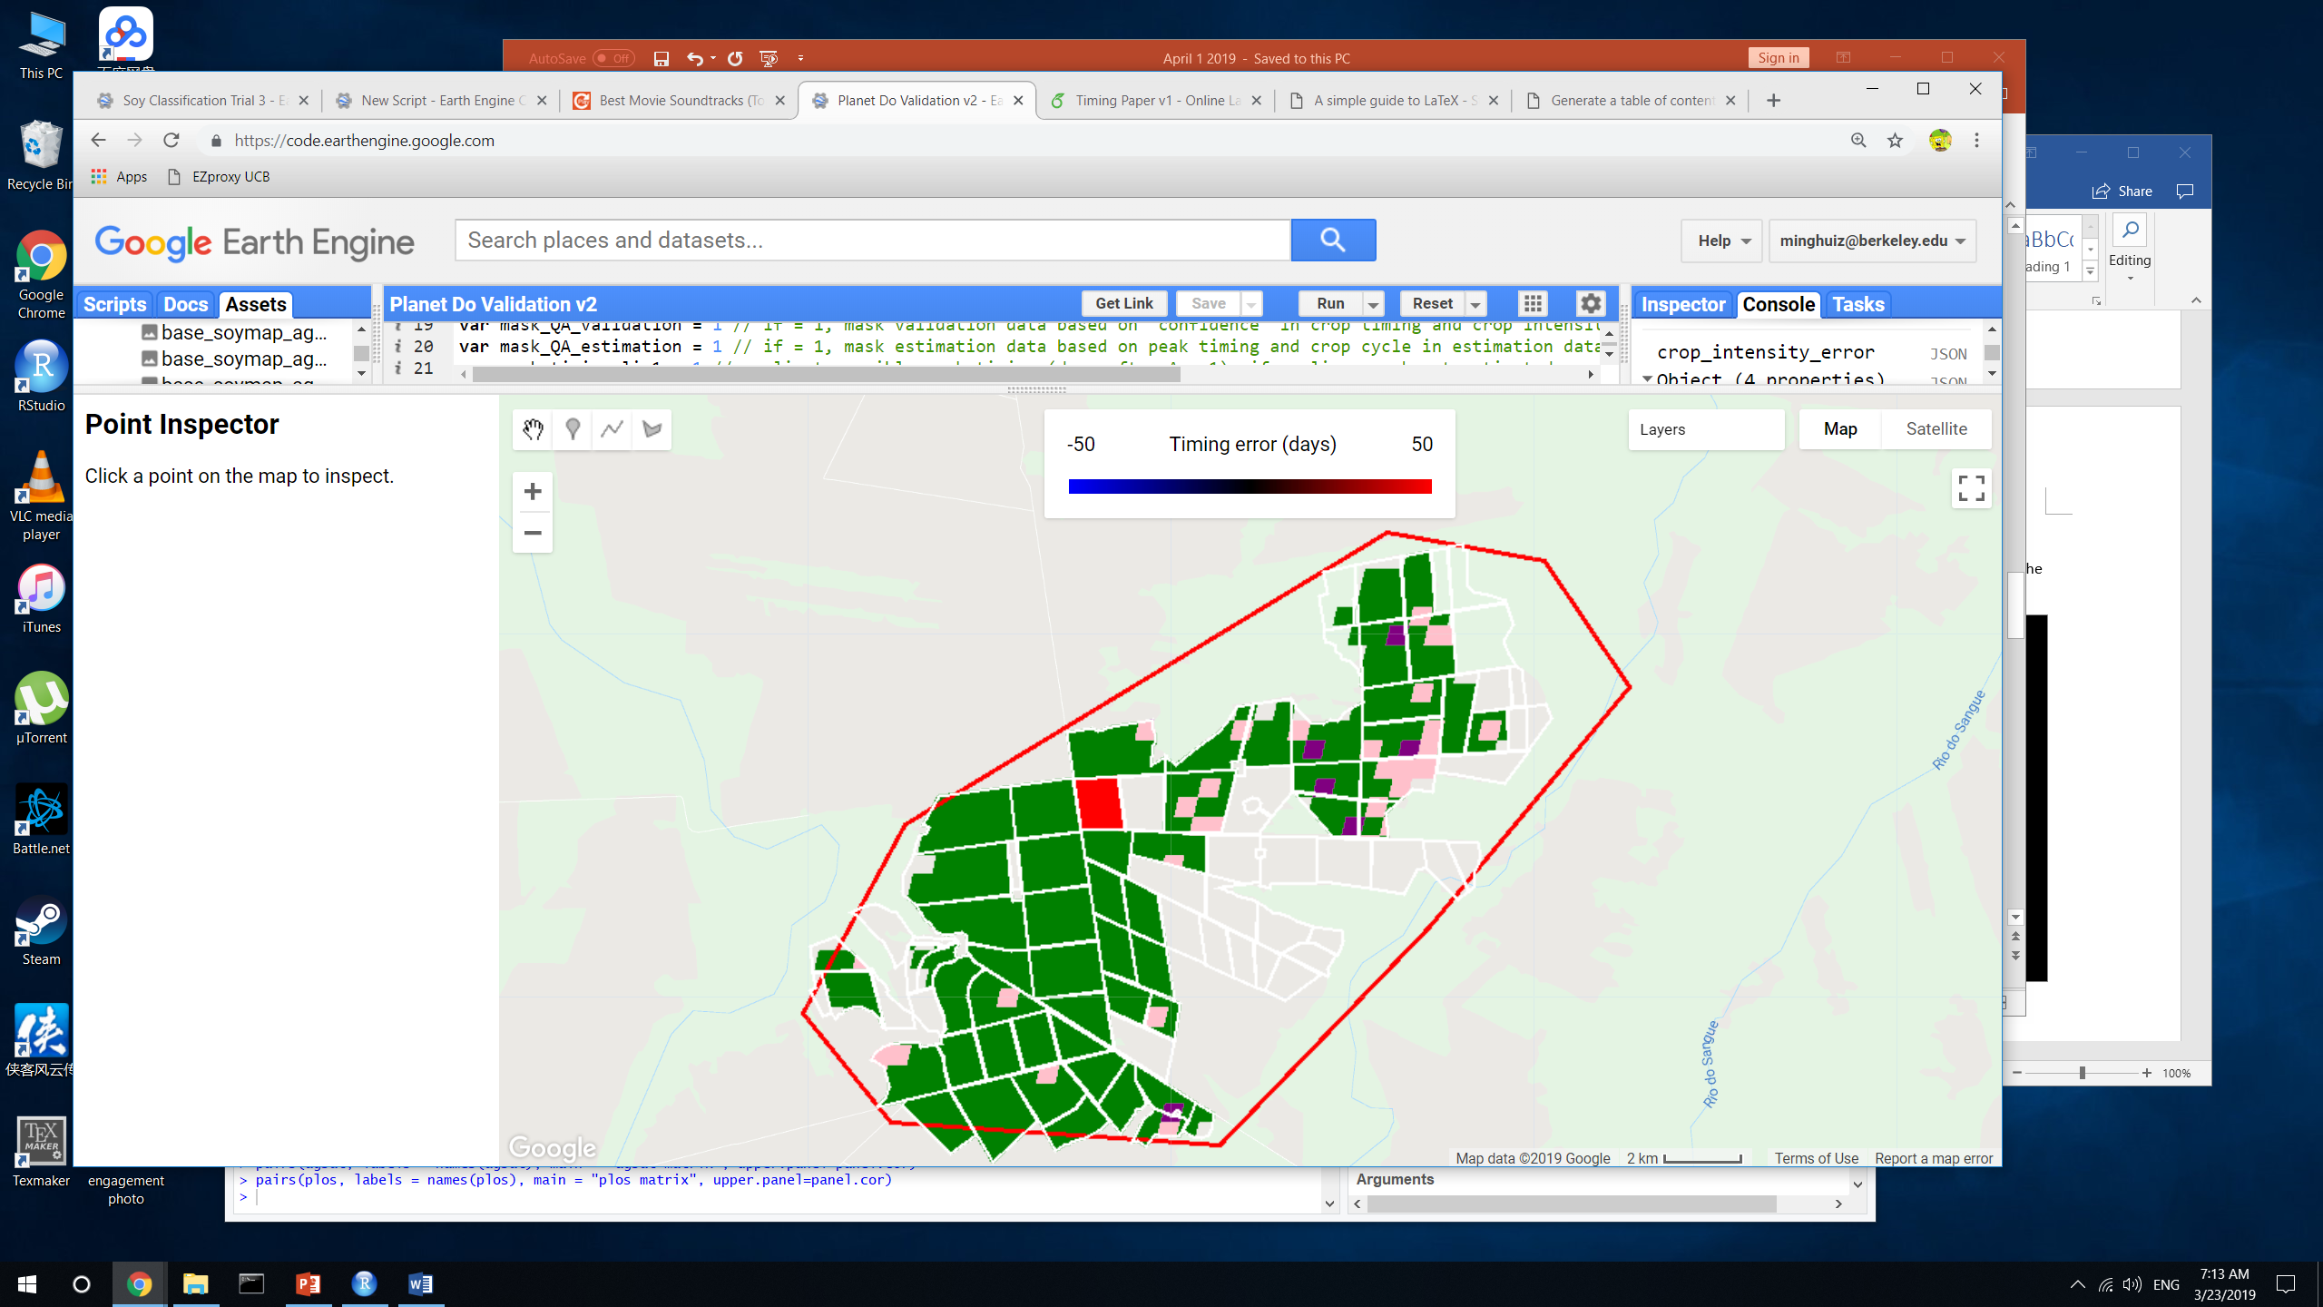
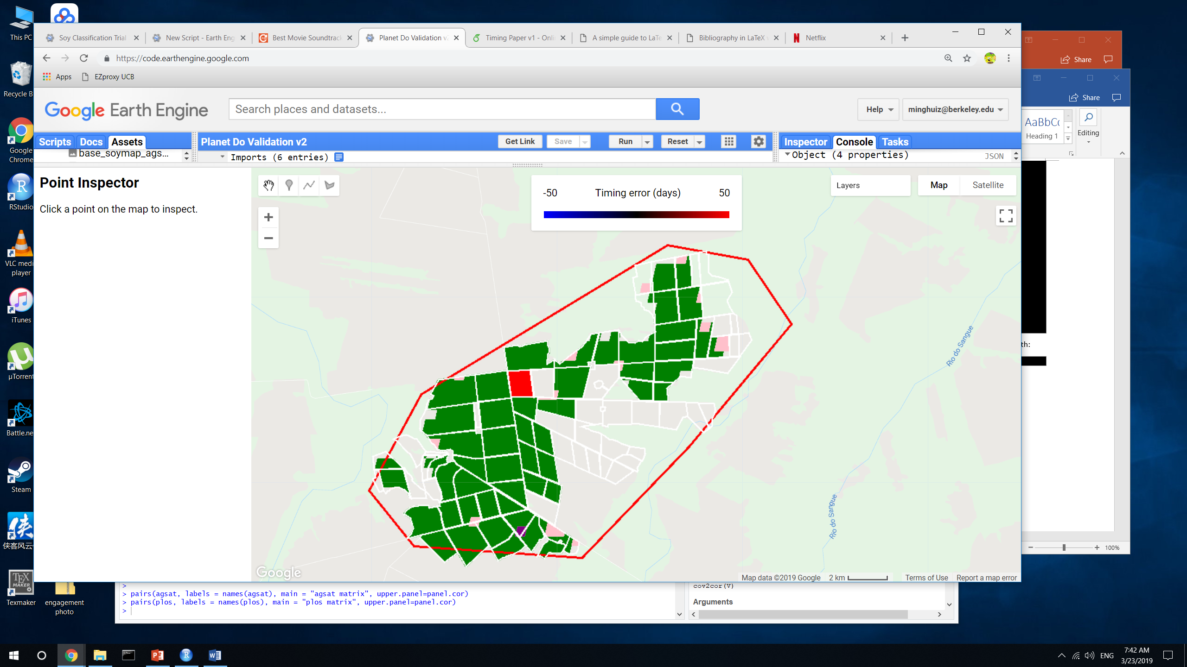
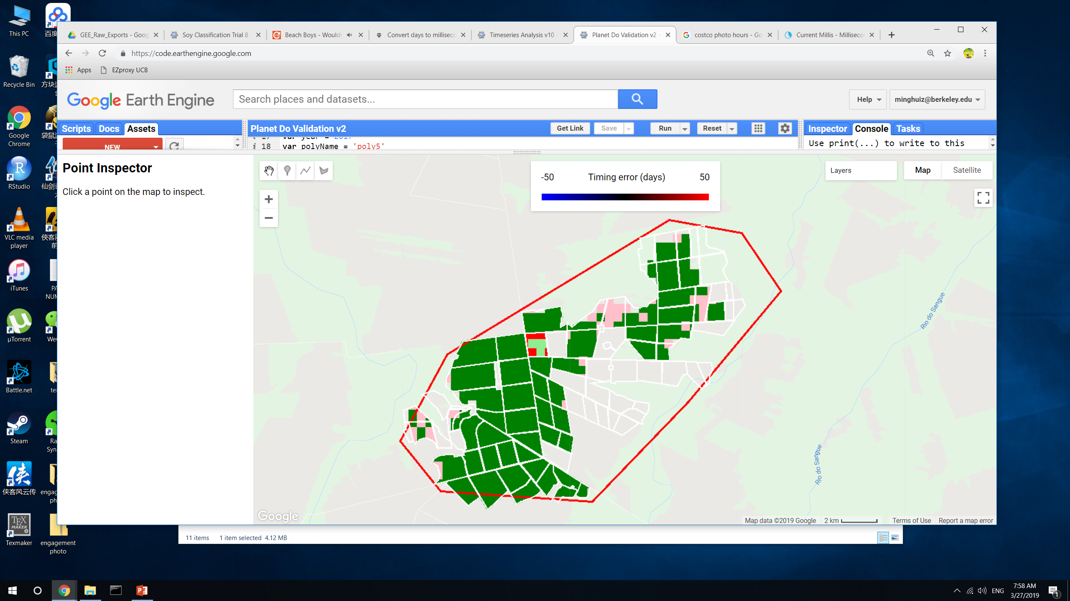
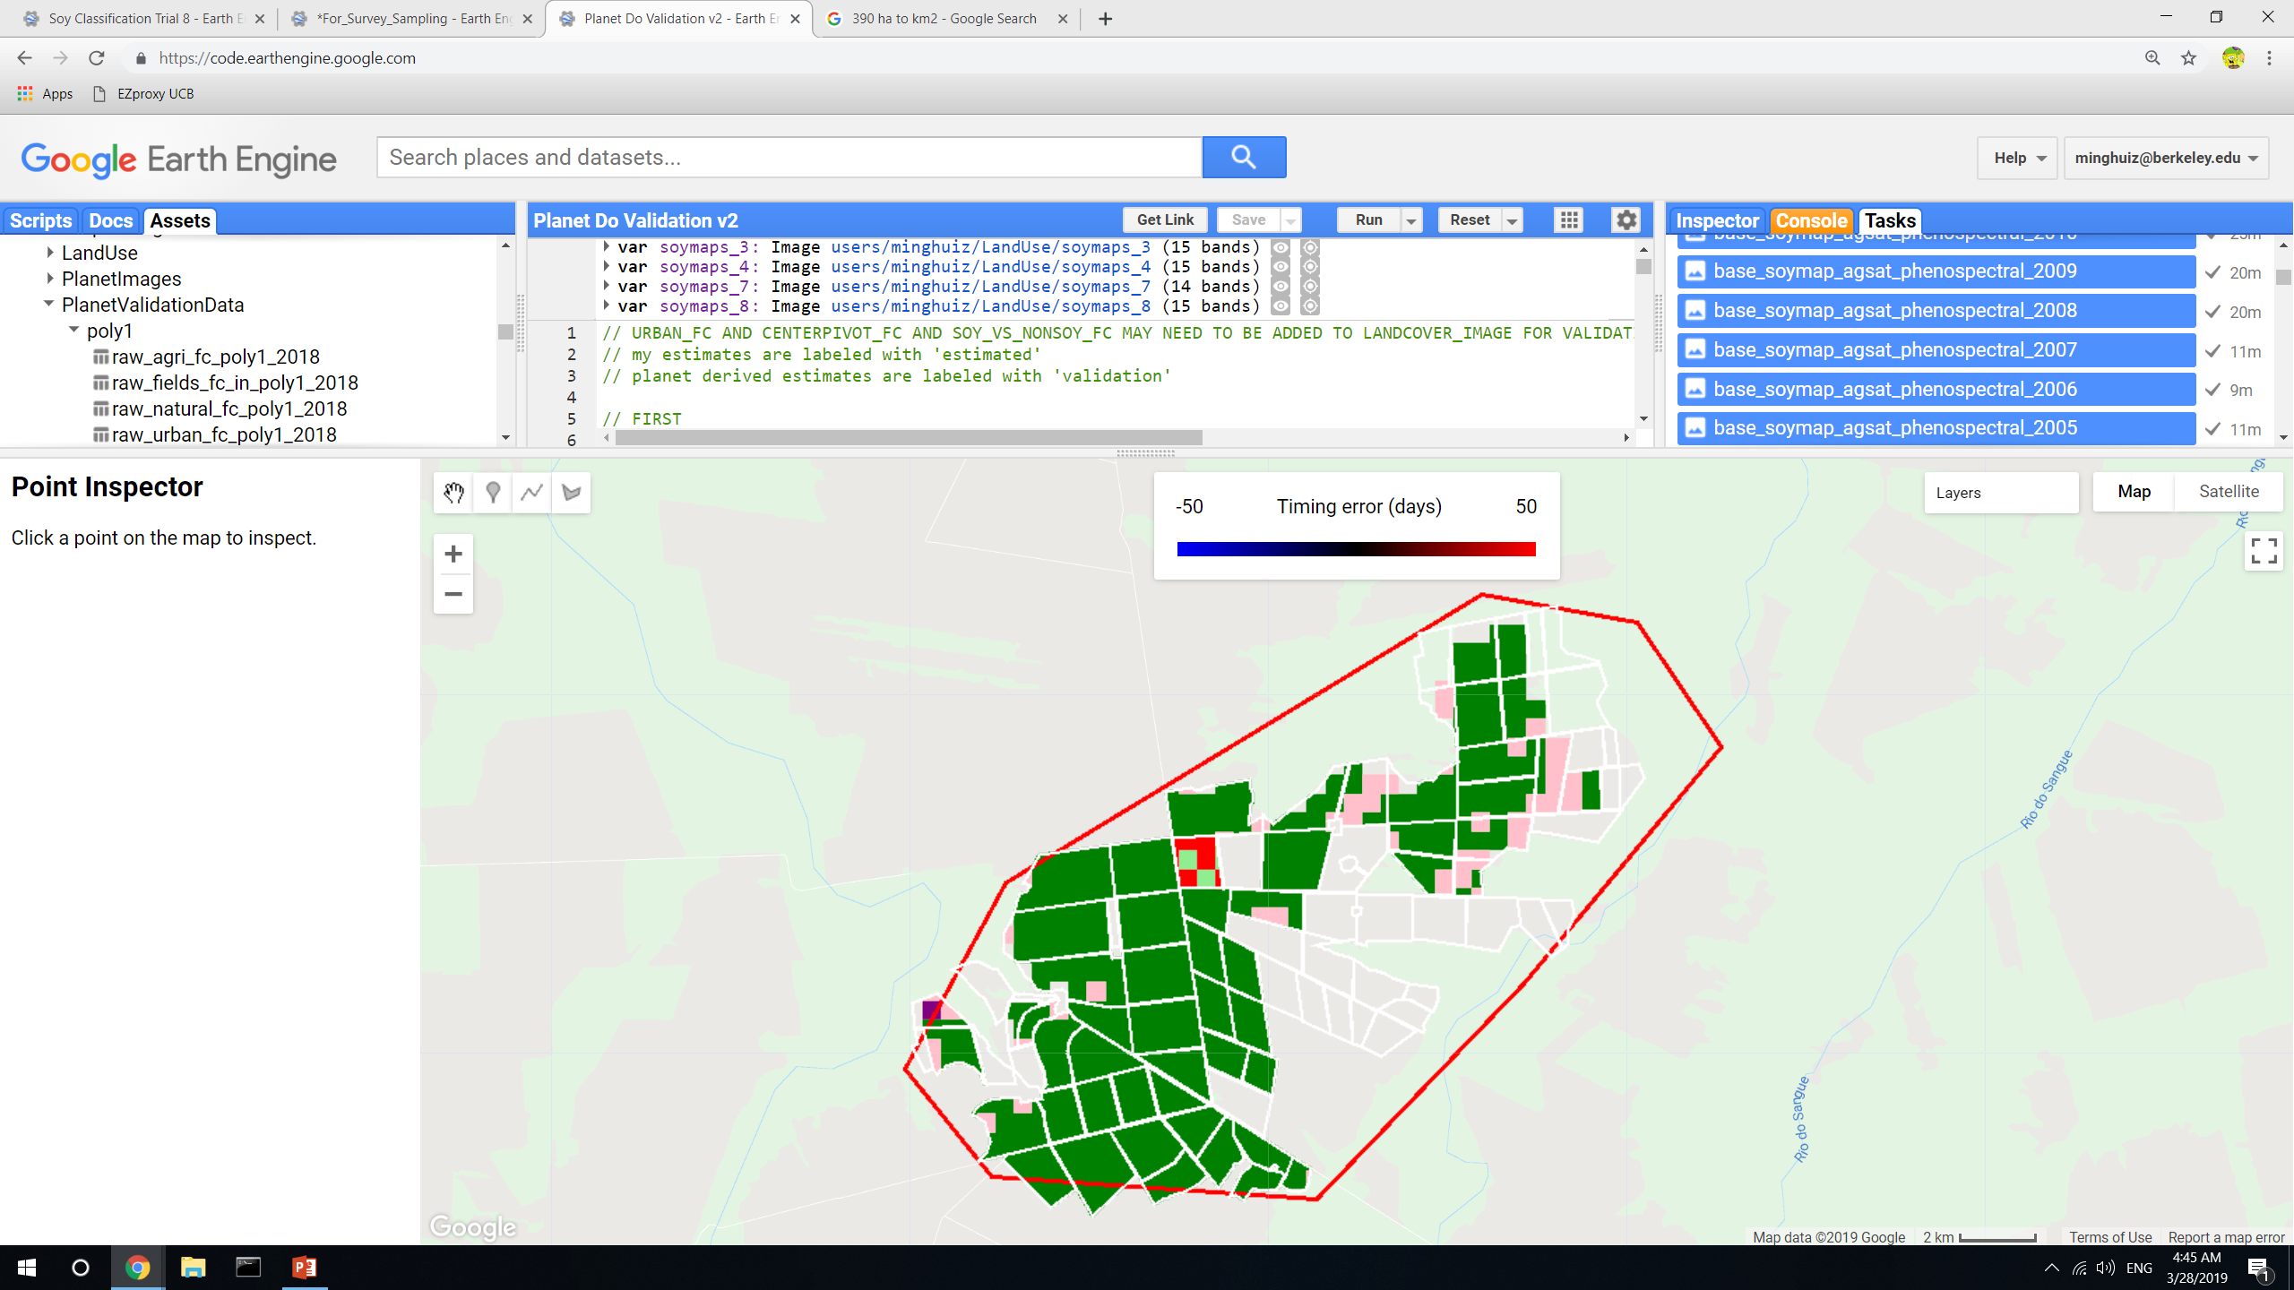
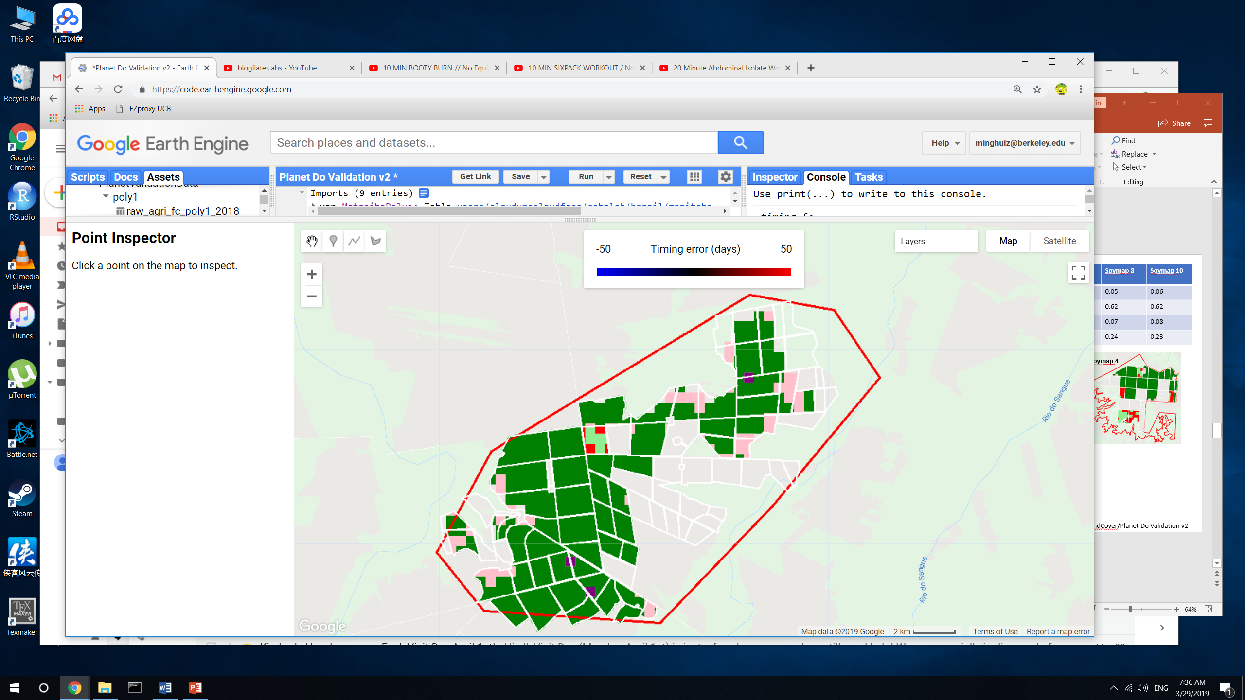
Land classification accuracy for poly5 (MT)
True SC = light green
True DC = green
False SC = pink
False DC = red
False nonsoy agri = purple
False agri (actually natural) = gray
 | Jake’s soymap | Soymap 1 | Soymap 2 | Soymap 3 | Soymap 4 | Soymap 7 | Soymap 8 | Soymap 10
True SC | 0.01 | 0.005 | 0.015 | 0 | 0.002 | 0.01 | 0.01 | 0.01
True DC | 0.78 | 0.86 | 0.9 | 0.89 | 0.93 | 0.87 | 0.87 | 0.84
False SC | 0.18 | 0.11 | 0.07 | 0.07 | 0.04 | 0.1 | 0.1 | 0.12
False DC | 0.02 | 0.03 | 0.02 | 0.03 | 0.03 | 0.02 | 0.02 | 0.02
Jake’s soymap
Soymap 1
Soymap 2
Soymap 3
Soymap 4
Soymap 7
Soymap 8
Soymap 10
GEE file: LandCover/Planet Do Validation v2

Slide 6
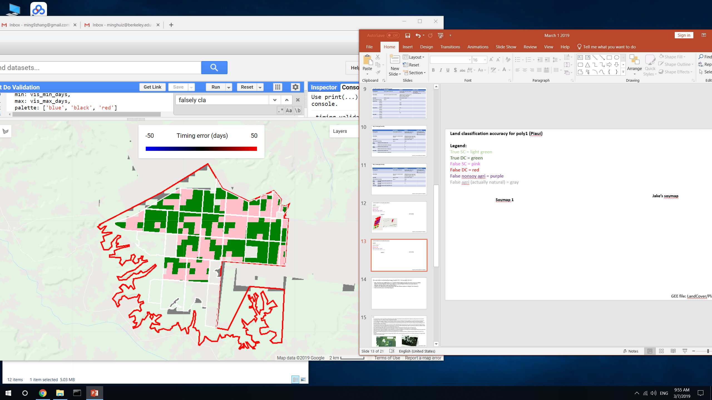
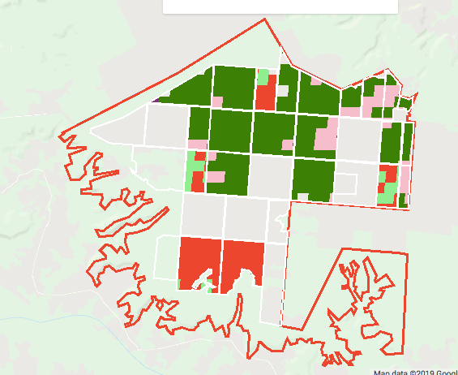
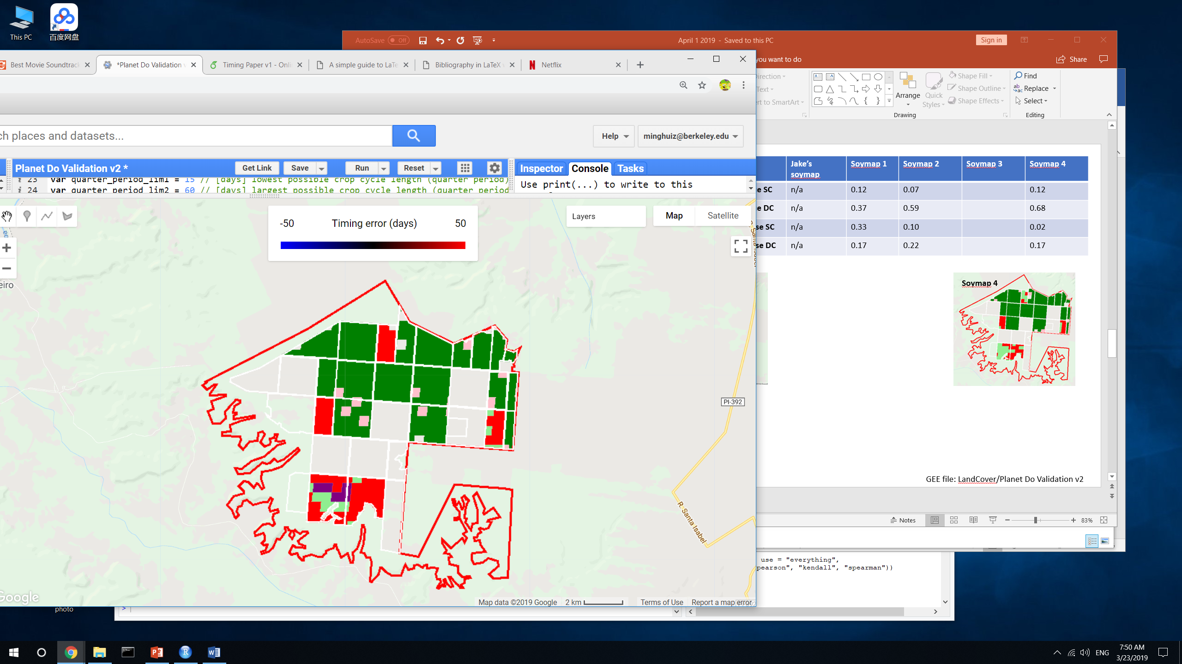
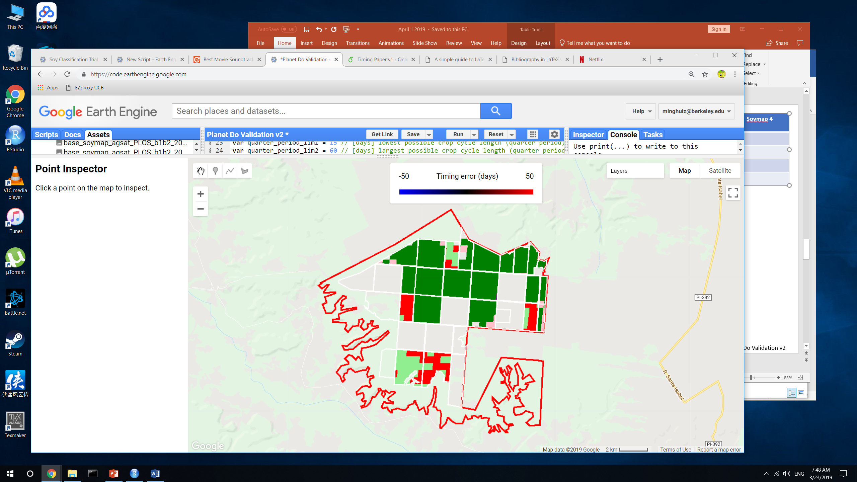
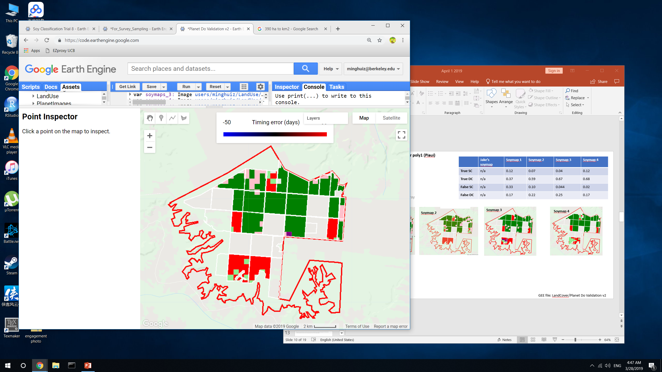
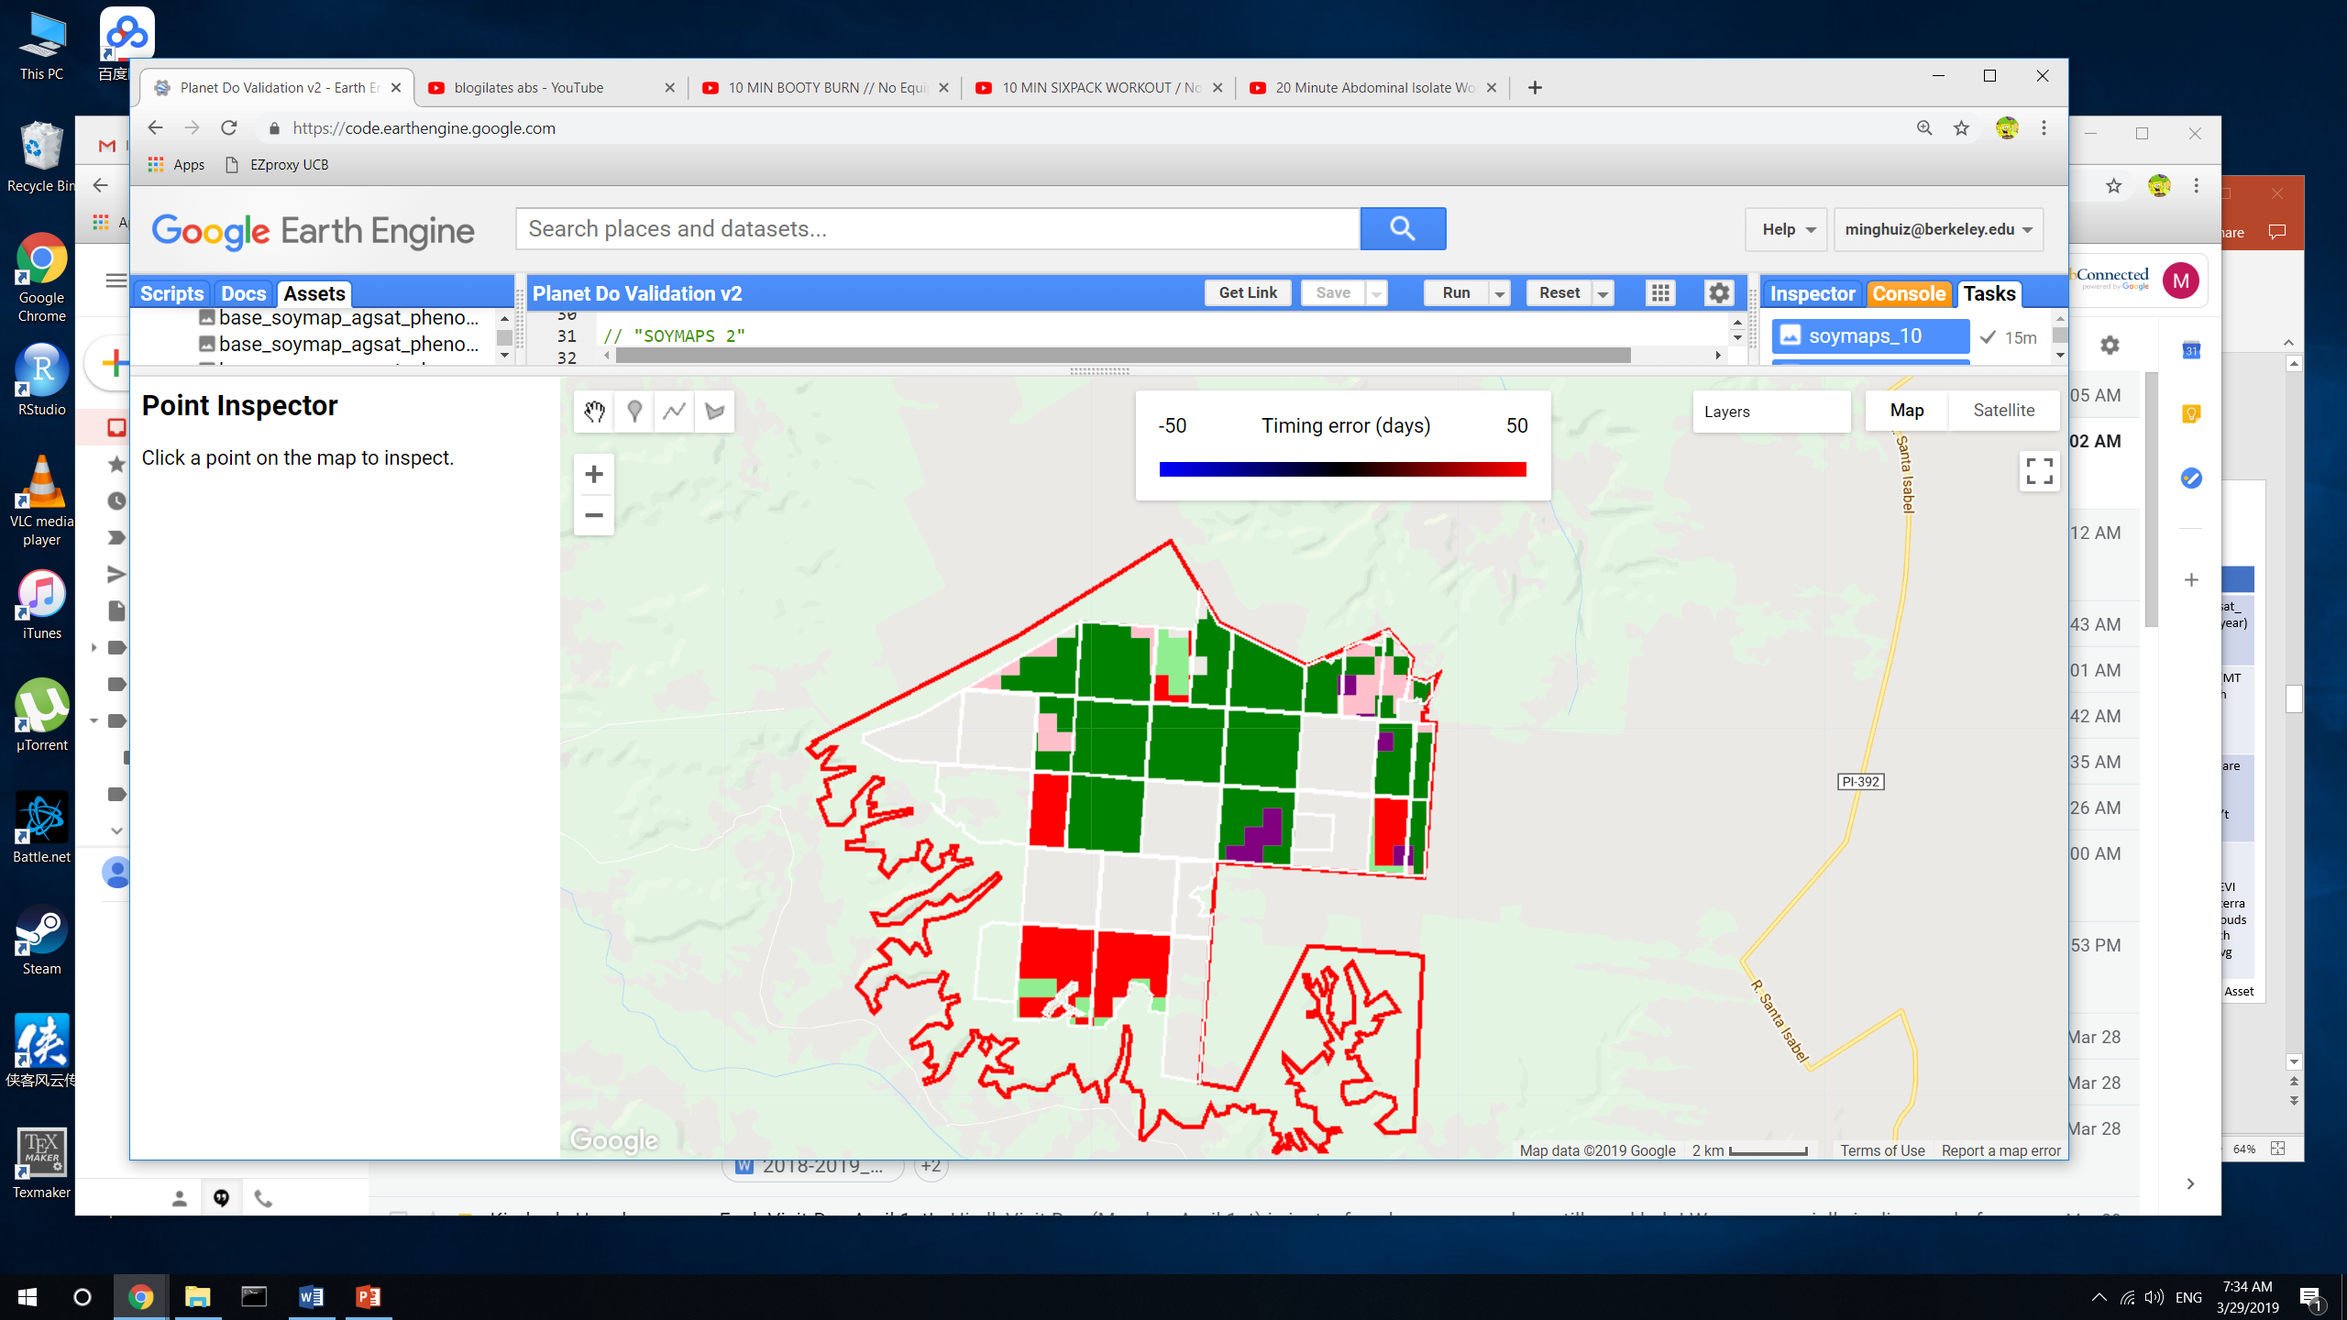
Land classification accuracy for poly1 (Piaui)
Legend:
True SC = light green
True DC = green
False SC = pink
False DC = red
False nonsoy agri = purple
False agri (actually natural) = gray
 | Jake’s soymap | Soymap 1 | Soymap 2 | Soymap 3 | Soymap 4 | Soymap 8 | Soymap 10
True SC | n/a | 0.12 | 0.07 | 0.04 | 0.12 | 0.05 | 0.06
True DC | n/a | 0.37 | 0.59 | 0.67 | 0.68 | 0.62 | 0.62
False SC | n/a | 0.33 | 0.10 | 0.044 | 0.02 | 0.07 | 0.08
False DC | n/a | 0.17 | 0.22 | 0.25 | 0.17 | 0.24 | 0.23
Soymap 1
Soymap 2
Soymap 3
Soymap 4
Soymap 8
Soymap 10
GEE file: LandCover/Planet Do Validation v2

Slide 7
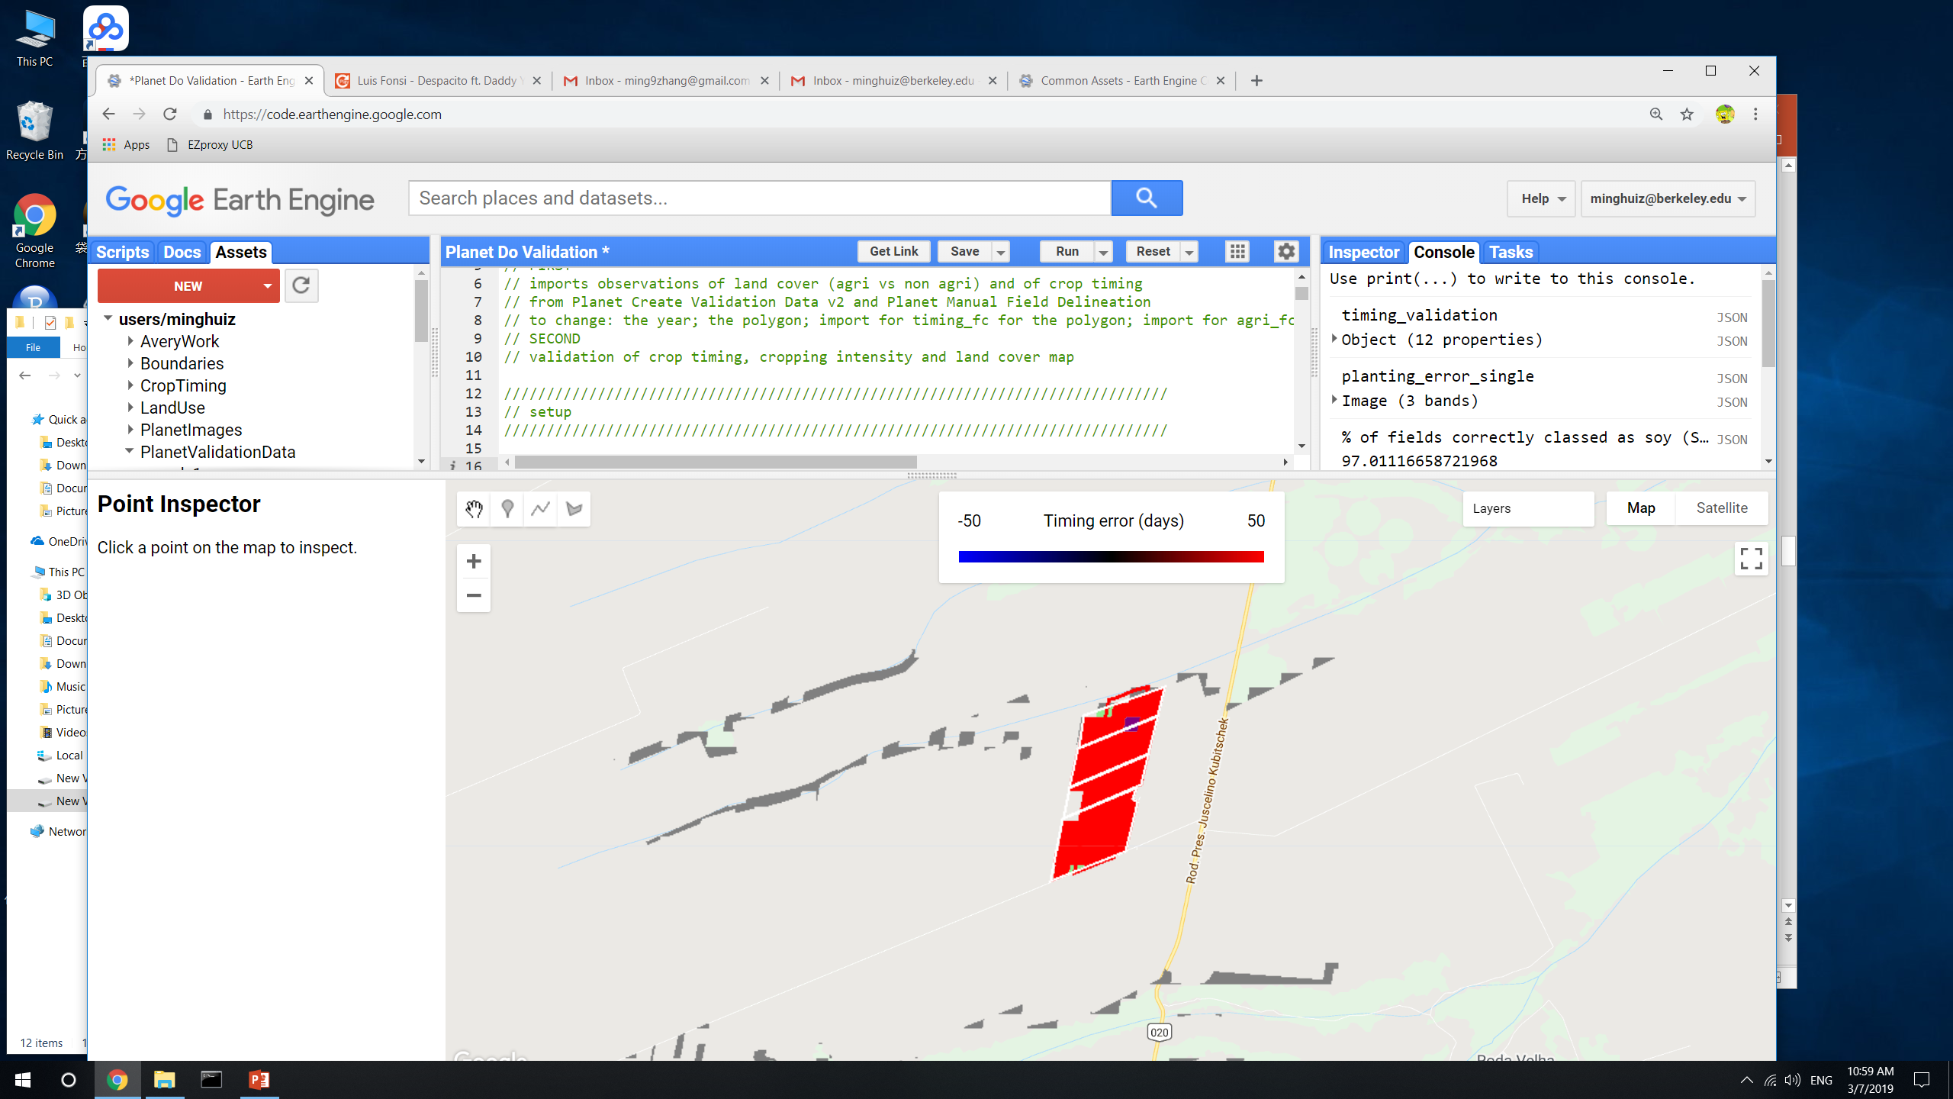
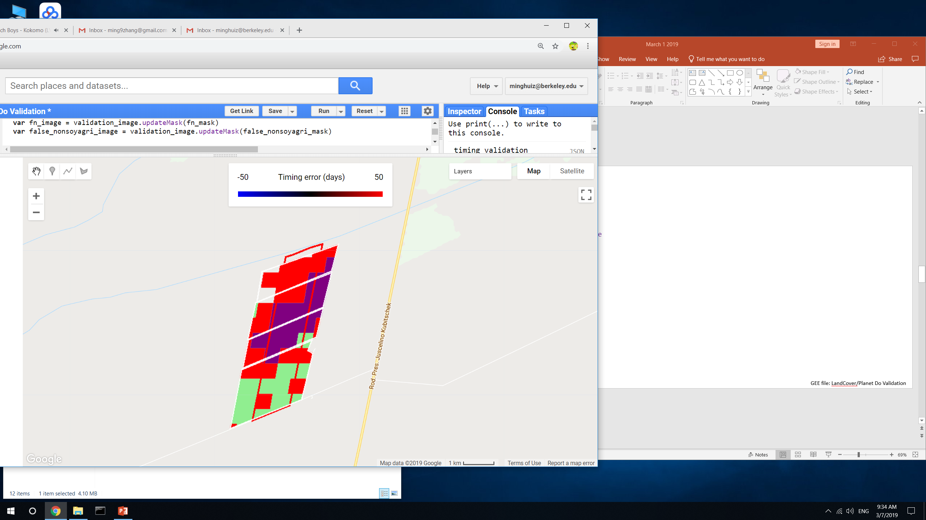
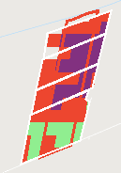
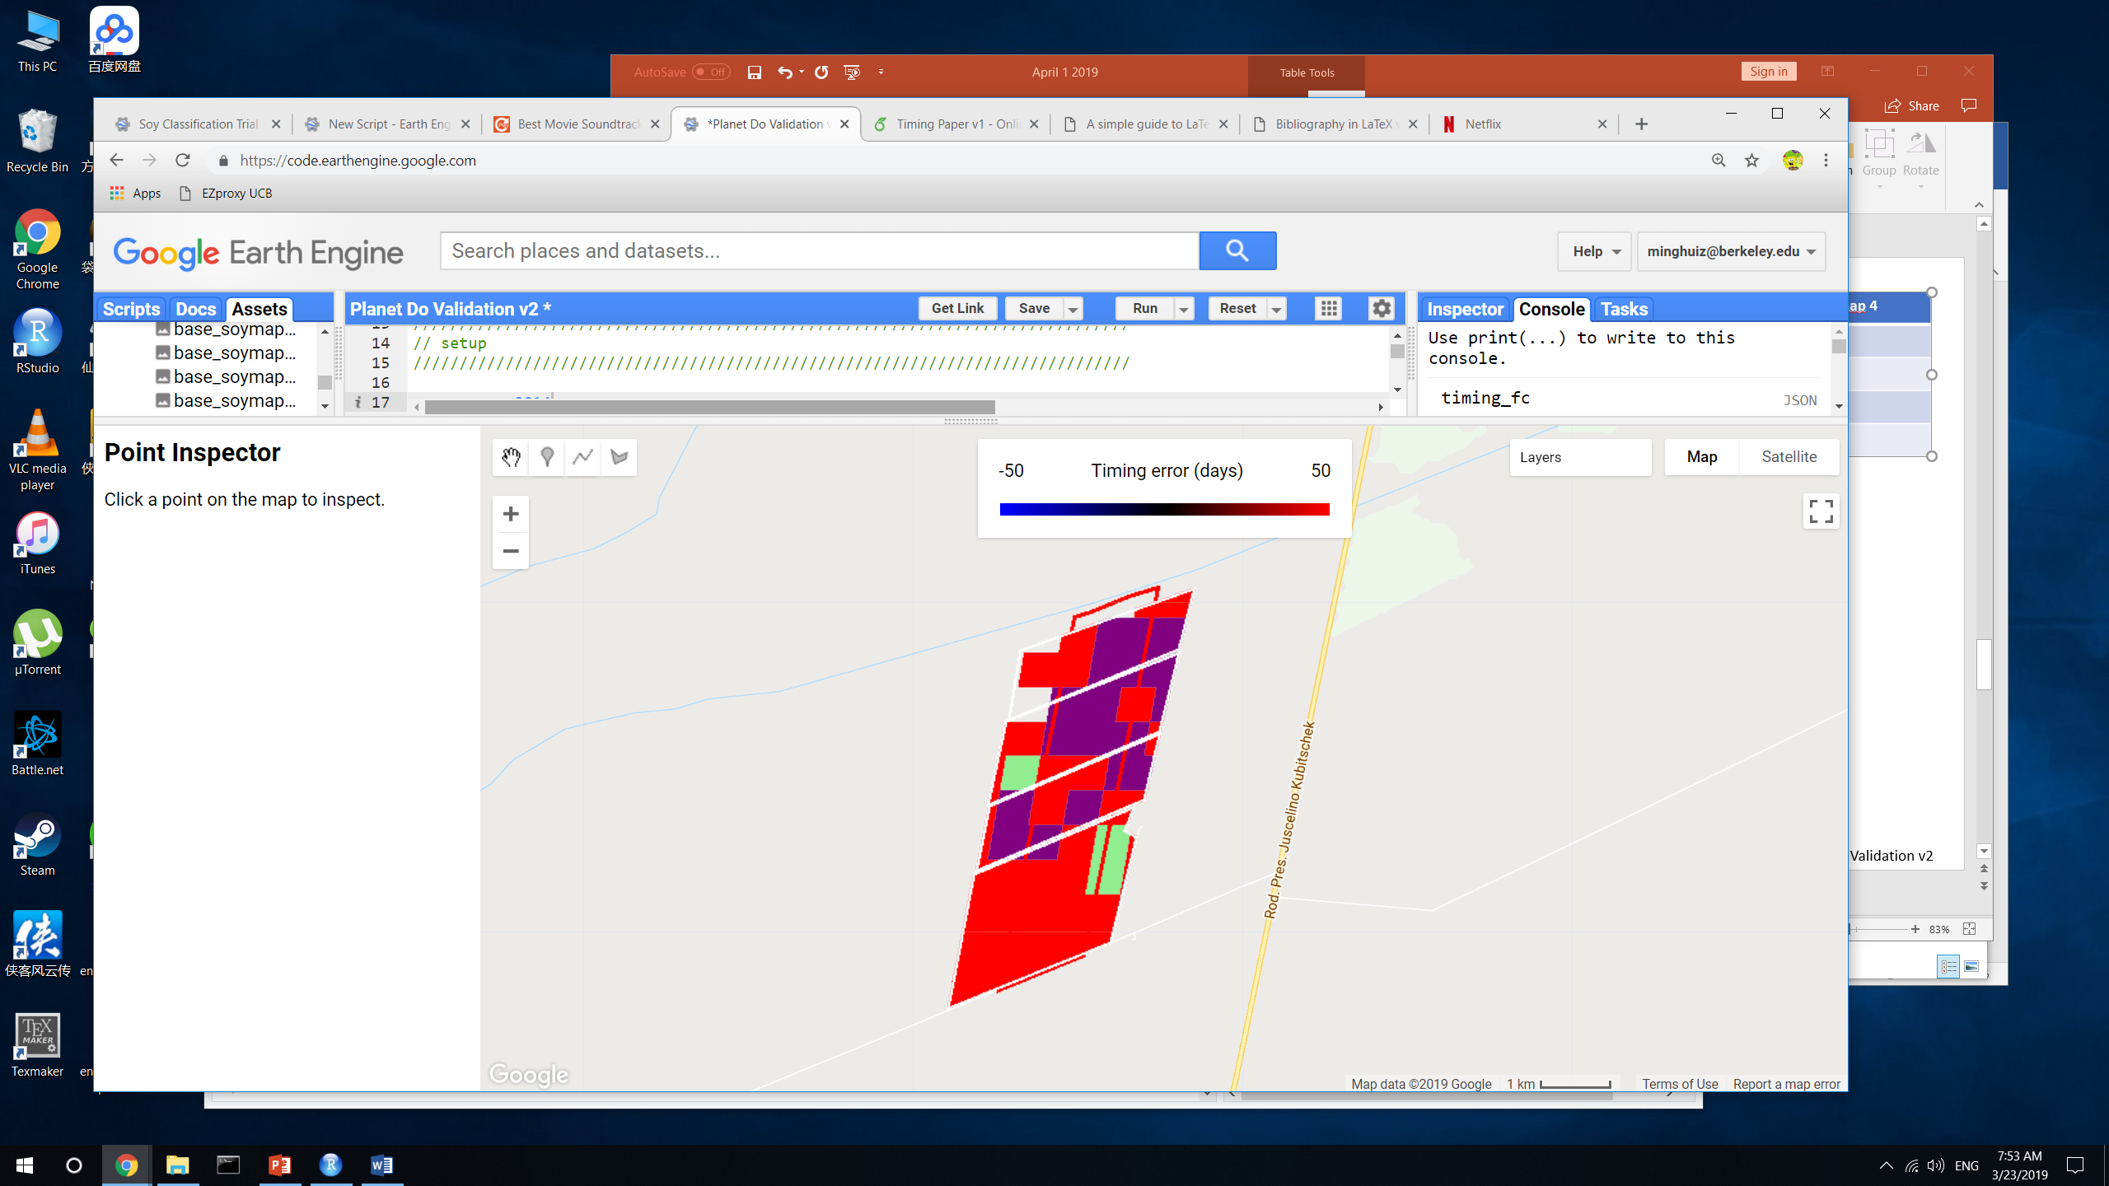
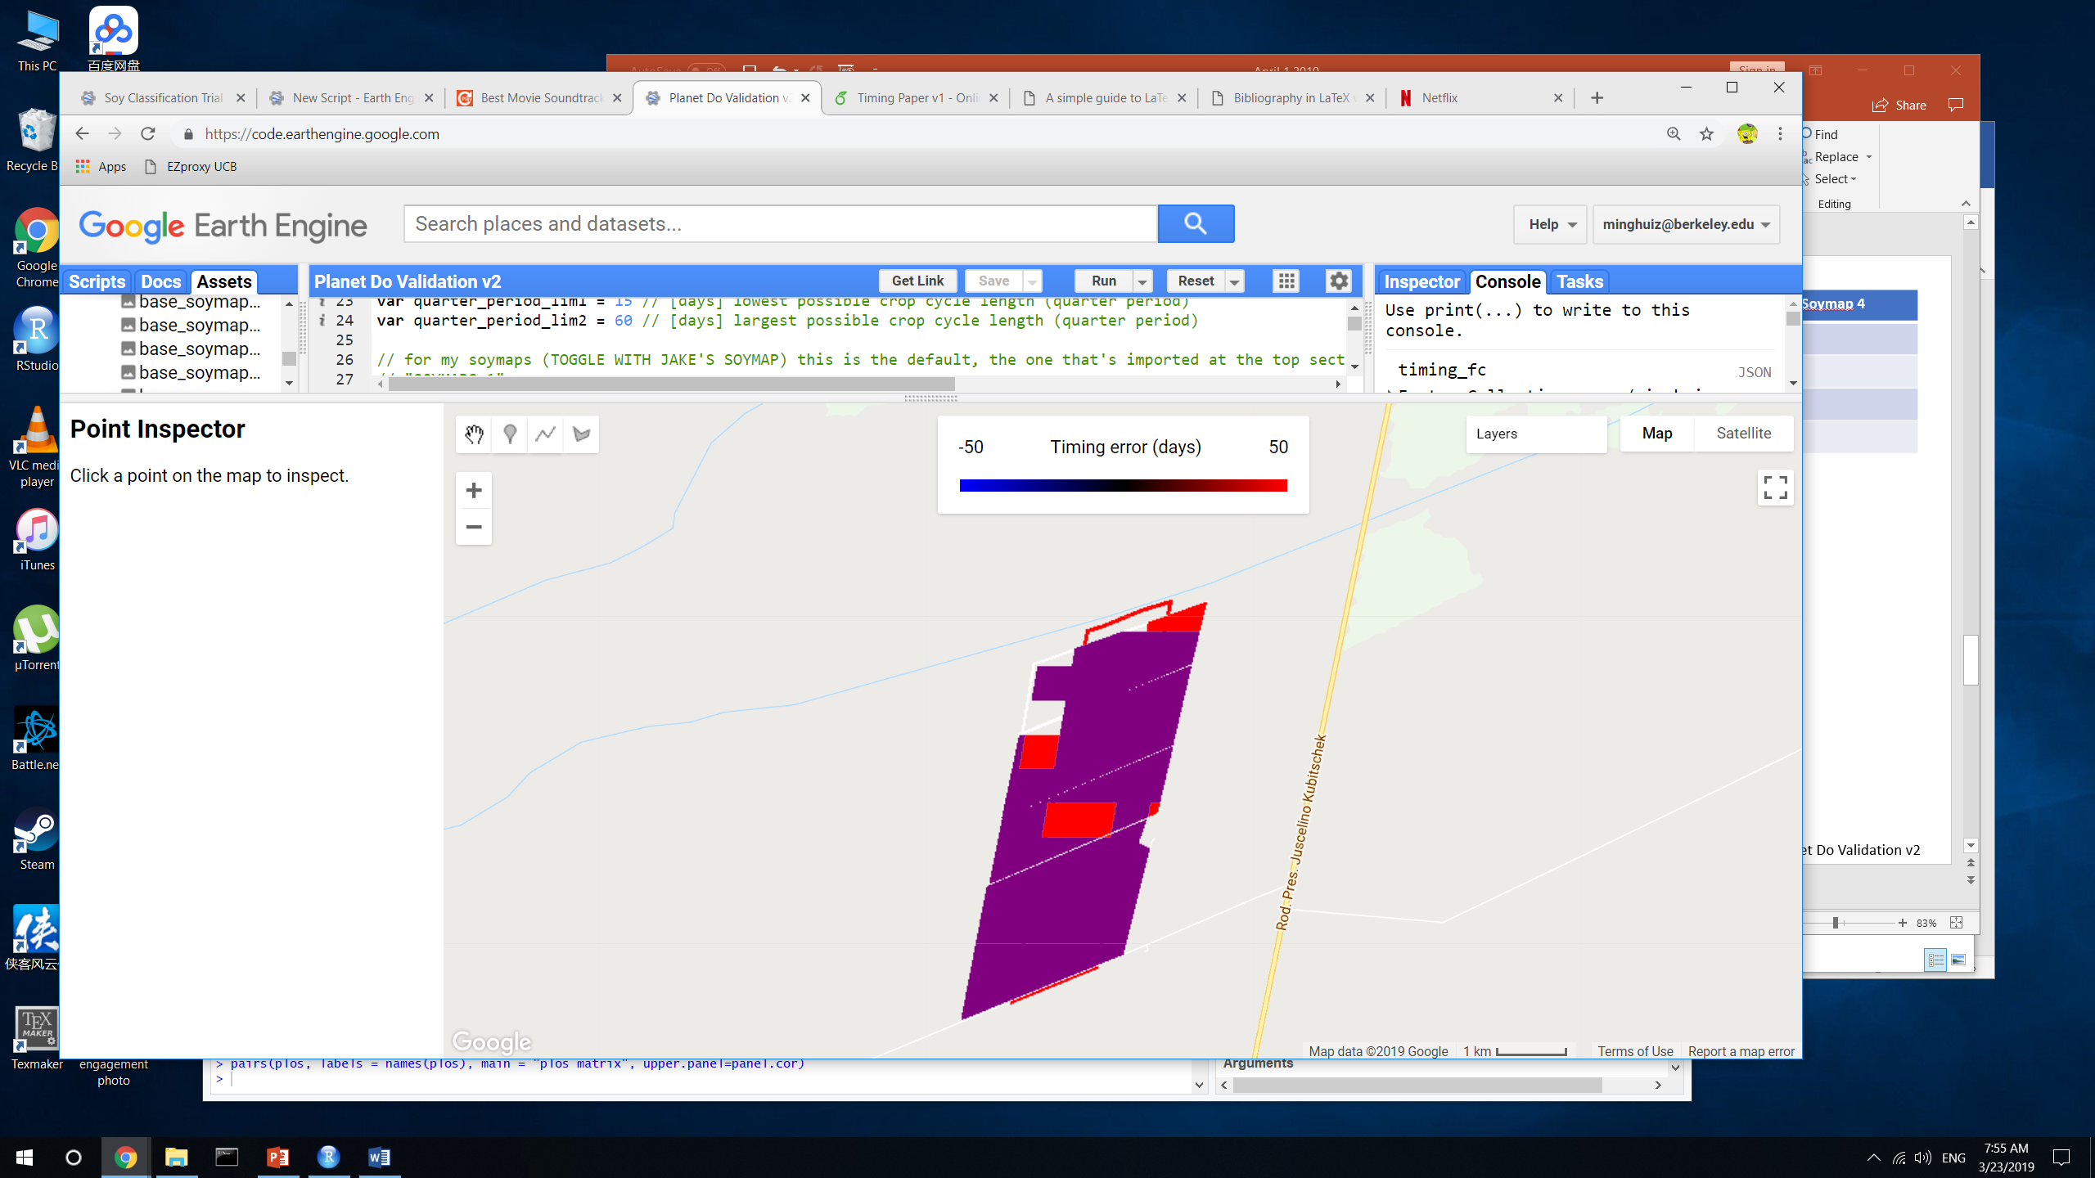
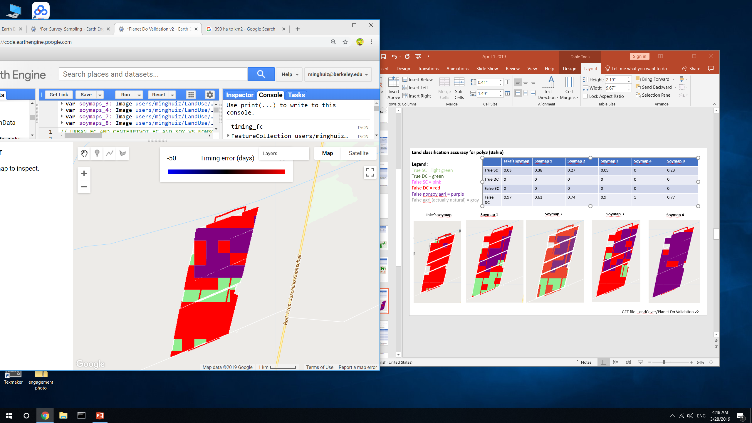
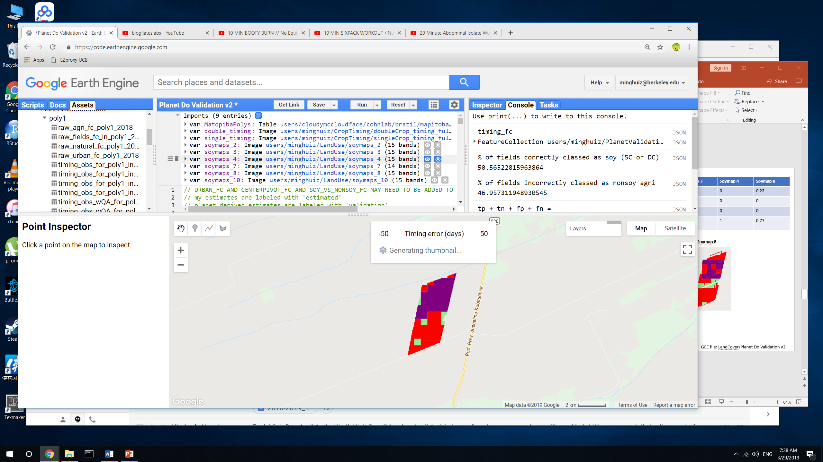
Land classification accuracy for poly3 (Bahia)
Legend:
True SC = light green
True DC = green
False SC = pink
False DC = red
False nonsoy agri = purple
False agri (actually natural) = gray
 | Jake’s soymap | Soymap 1 | Soymap 2 | Soymap 3 | Soymap 4 | Soymap 8
True SC | 0.03 | 0.38 | 0.27 | 0.09 | 0 | 0.23
True DC | 0 | 0 | 0 | 0 | 0 | 0
False SC | 0 | 0 | 0 | 0 | 0 | 0
False DC | 0.97 | 0.63 | 0.74 | 0.9 | 1 | 0.77
Jake’s soymap
Soymap 1
Soymap 2
Soymap 3
Soymap 4
Soymap 8
Soymap 10
GEE file: LandCover/Planet Do Validation v2

